Slide 1
Digital Engineering 1
Lecture 1

Slide 2
Digital Engineering 1
Welcome to Digital Engineering 1
Lecturer: Hilal Tayara
hilaltayara@jbnu.ac.kr
Office: Global Frontier College, 333
Office hours: Tuesday 09-00 AM - 10.00 AM
Lectures:
Monday: 15:00-17:00
Wednesday: 15:00-116:00
Due to Covid-19, we will have non-face-to-face classes
All lectures’ materials are uploaded to new LMS: https://ieilms.jbnu.ac.kr/
You must watch the uploaded videos within a week of upload, so it can be counted attendance.

Slide 3
Contents
Introduction
Boolean Algebra
Karnaugh Maps
Combinational circuits
Sequential circuits
Finite state machines
Multiplexers, Decoders, …
Flip-Flops
Introduction to FPGA

Slide 4
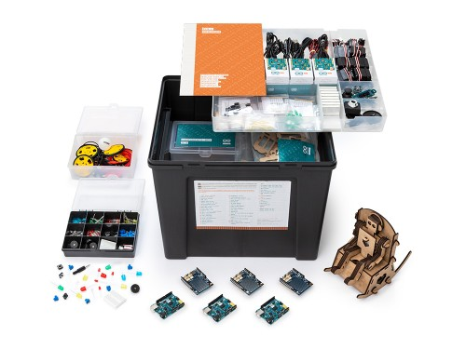
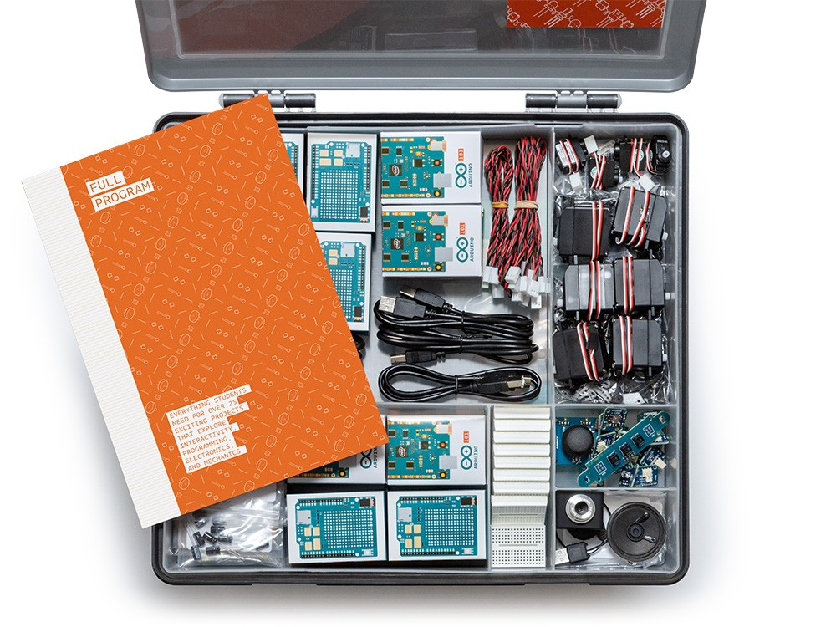
Contents
Arduino programming (4 projects)
Six Arduino 101 boards
Six Arduino Education shields
More than 10 mini breadboards
Set of electronic components
Set of sensors and actuators
Media and storage
Set of cables

Slide 5


Slide 7


Slide 12
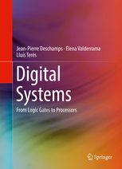
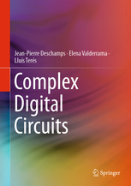
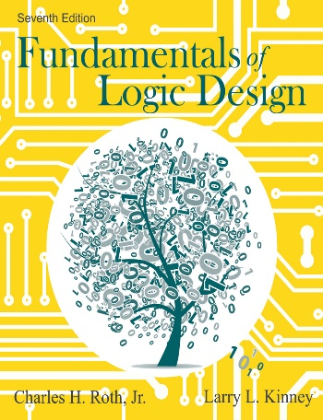
Books
Digital Systems: From Logic Gates to Processors. Deschamps JP, Valderrama E, Terés L. Springer 2017. ISBN 978-3-319-41198-9.
Complex Digital Circuits. Deschamps JP, Valderrama E, Terés L. Springer 2019 (available now). ISBN 978-3-030-12653-7.
Fundamentals of Logic Design 7th Edition by Jr. Charles H. Roth, Larry L Kinney, ISBN-10 : 1133628478

Slide 13
Grading
Tentative and subject to change
Midterm 25%
Final 35%
Assignments, projects 30%
Attendance 10%

Slide 14
Course Overview
To understand, analyze and design digital (logic) circuits.
Basic logic theory, analysis and design of combinational and sequential logic circuits.
Computer arithmetic circuits.
Advanced topics in digital design.

Slide 15
Motivation
Computers contributed to various industrial, scientific and commercial advances.
Computers currently are the main tools in big complex systems.
The general-purpose digital computers are a good example of a digital system.
Also, Digital phones, digital displays, video games, clocks, learning toys, digital control systems, home appliances, etc.
All digital systems operate based on the same concepts that we will study in this class. The main difference is the complexity of the circuits.

Slide 16
Digital vs Analog Systems
The information in the digital systems are represented in discrete rather than continuous forms
The systems that are based on continuous forms of information are called analog systems.

Slide 17
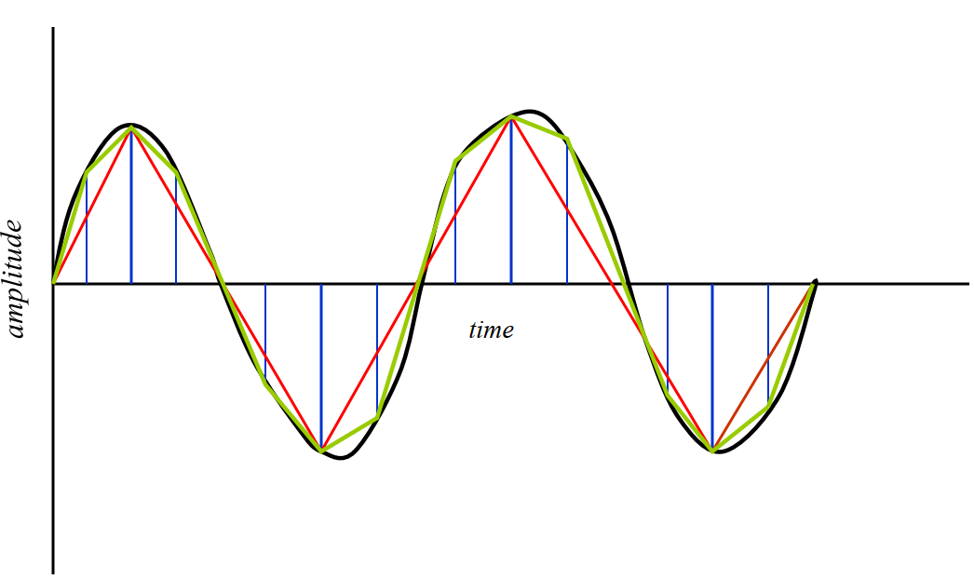
Continuous and Discrete
Notes:
d

Slide 18
Advantages of Digital Systems
Easier in processing
Easier in designing high speed digital circuits.
Provides grater precision and range for dealing with numerical information compared to analog signals.
Give the same set of the inputs, the output of the digital circuit gives similar results to analog circuit.
The storage and retrieval functions of the information are easier to implement in digital form than in analog
Digital circuits could have built-in error detection and correction.

Slide 19
Disadvantages of Digital Systems
World outside a digital computer is analog!
Solution
Digital system
Analog to Digital Converter (ADC)
Digital to Analog Converter (DAC)

Slide 20


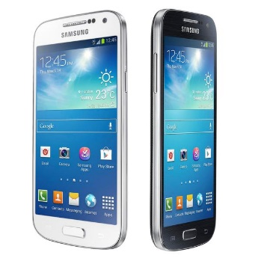
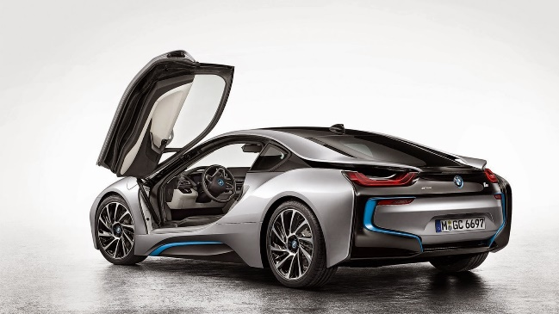



Digital Systems?

Slide 21
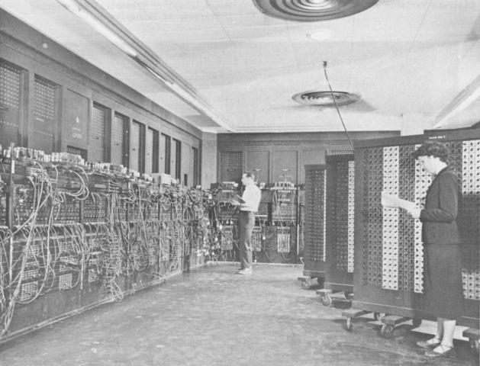
1946 in UPenn Measured in cubic ft

Slide 22
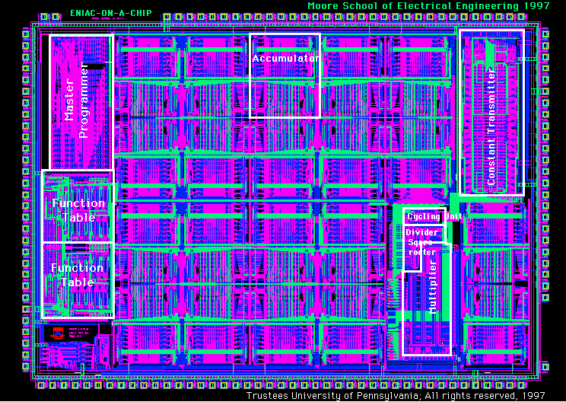
ENIAC on a Chip
Introduced 1997
It had 174,569 transistors
7.44 mm x 5.29 mm
0.5 technology

Slide 23
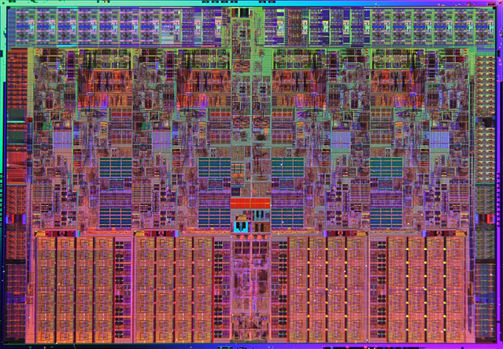
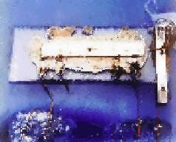
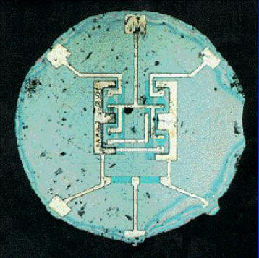
Integrated Circuit Revolution
1958: First integrated circuit (germanium)
Built by Jack Kilby at Texas Instruments
Contailed five components : transistors,
resistors and capacitors
263 mm²
731,000,000 transistors
45 nm process
4 cores

Slide 24
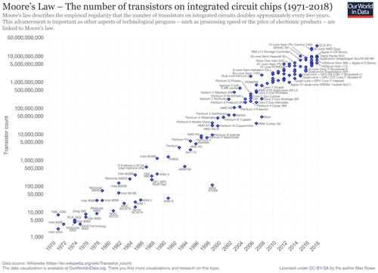
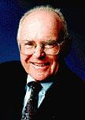
Moore’s Law
Gordon Moore
Intel Co-Founder and Chairmain Emeritus
Image source: Intel Corporation www.intel.com
Moore's law is the observation that the number of transistors in a dense integrated circuit (IC) doubles about every two years.
A semi-log plot of transistor counts for microprocessors against dates of introduction, nearly doubling every two years.
https://en.wikipedia.org/wiki/Moore%27s_law

Slide 25
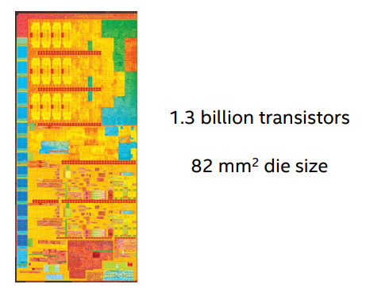
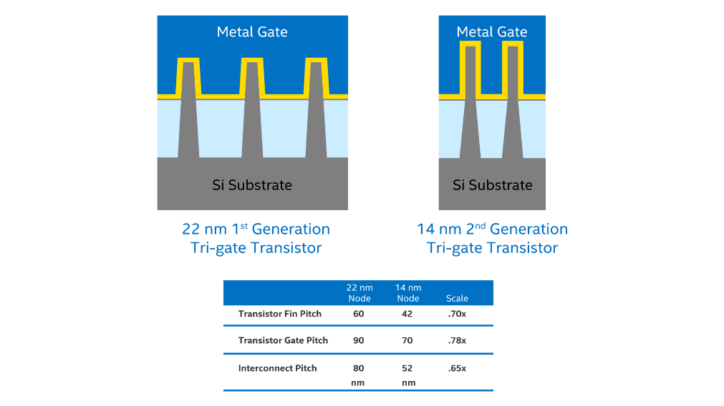
14 nm Intel Core M Processor
https://www.intel.com/content/dam/www/public/us/en/documents/technology-briefs/bohr-14nm-idf-2014-brief.pdf
https://www.intel.com/content/www/us/en/silicon-innovations/intel-14nm-technology.html

Slide 26
Scaling
The process of shrinking the layout in which every dimension is reduced by a factor is called Scaling.
Transistors become “Smaller, faster and consume less power”.
Designs have smaller die sizes, higher yield and increased performance.

Slide 27
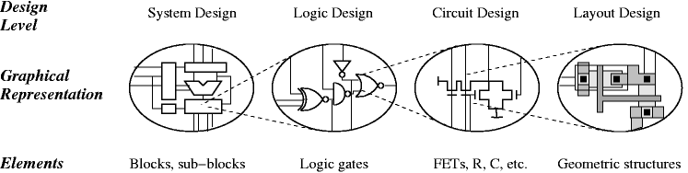
Design complexity

